Slide 1
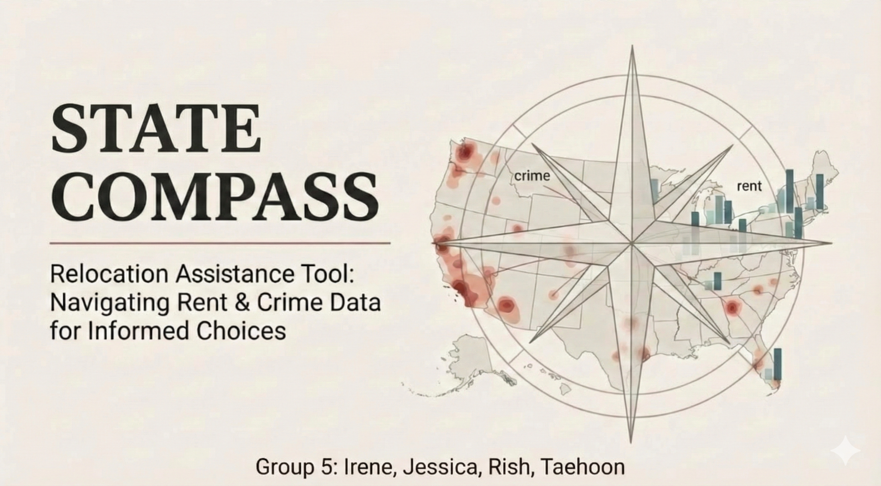

Slide 2

The Relocation Headache
Where should we move?
The Trade-Off Trap
Information Overload
Notes:
Relocating sounds exciting, but for most people it quickly becomes a headache.
First, there’s the big question — where should we move? Millions of Americans ask it every year, and it’s overwhelming.
Then comes the trade-off trap: affordable places often feel less safe, while safer areas can be too expensive.
And finally, information overload — you have to check FBI crime reports, rent websites, forums, and news sources just to piece together a basic picture.
Our tool solves all three problems in one place.

Slide 3



OUR SOLUTION?
STATE COMPASS
Aggregates Data
Finds Balance
Predicts Trends
Notes:
State Compass is your personal relocation assistant. It cuts through the noise to give you clear, objective facts.
What it does:
Aggregates Data: Pulls live safety and rent data automatically.
Finds Balance: Helps you find the "Sweet Spot" between cost and safety.
Predicts Trends: Tells you if a neighborhood is getting better or worse.

Slide 4
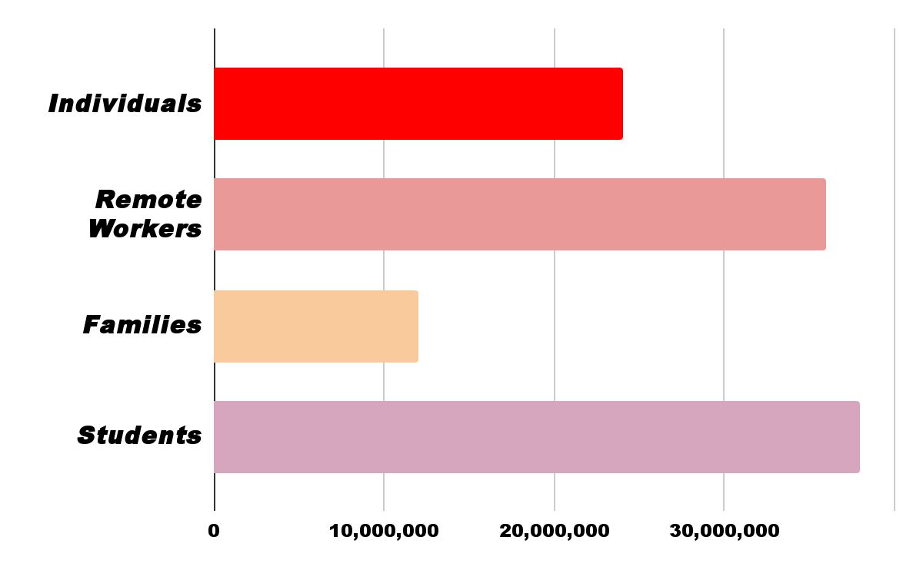
Target Users
102 Million + USERS
Notes:
Our tool serves a massive audience.
First, you have individuals — over 25 million people relocate across states every year, many because of work or lifestyle changes.
Then there’s the rapidly growing group of remote workers, more than 35 million, who can live anywhere and are highly sensitive to cost-of-living and safety differences.
Families are another major segment. They prioritize safety and school environments, and they often face the hardest trade-offs between crime and affordability.
Finally, there are nearly 20 million students and young professionals who move frequently and need quick, data-driven comparisons.
Altogether, this creates a target market of over 100 million potential users who face the same decision: where should I live next?

Slide 5
Powered by Real Government Data
FBI Crime Data
We stream monthly crime reports directly from the Federal Bureau of Investigation's API to ensure you have the latest safety stats.
HUD Rental Data
We fetch fair market rent prices for every state from the Department of Housing and Urban Development to give you accurate cost estimates.

Slide 6
Technical Challenges
Data Gaps
Challenge: Some states had missing monthly crime reports in the FBI API.
Solution: We implemented a cleaning pipeline using Pandas to interpolate missing values and exclude incomplete datasets to ensure accuracy.
API Latency
Challenge: High volume of API calls necessitated rescoping
Solution: We created a local csv file that saves data after the first fetch, making subsequent loads instant.

Slide 7
Features
Safety
Affordability
Geographic
Violent Crime Rate (assault, robbery, homicide)
Property Crime Rate (theft, burglary, vandalism)
Monthly trends over 12 months to identify seasonal patterns
1-Bedroom Rent (singles, couples)
2-Bedroom Rent (small families)
3-Bedroom Rent (growing families)
4-Bedroom Rent (larger households)
East Coast: Maine to Florida (Atlantic states)
West Coast: California, Oregon, Washington
Great Lakes: OH, MI, IN, WI, IL, MN
Mountain & Plains: Dakotas, MT, WY, CO, ID, IA, NE, KS, MO
Southwest: AZ, NM, NV, UT, AK, HI
South: TX, OK, AR, LA, MS, AL, TN, KY, WV

Slide 8
Top Performers
Top 5 Safest States
Idaho - 100.0
New Hampshire - 98.1
Rhode Island - 92.2
Maine - 90.0
Massachusetts - 84.6
Top 5 Most Affordable
Nebraska - 100.0
Arkansas - 99.9
Missouri - 98.9
Iowa - 98.5
West Virginia - 97.0

Slide 9






The Sweet Spot: Best of Both Worlds
States scoring 60+ on BOTH Safety and Affordability
20
states offer the winning combination
Idaho
Wisconsin
Safety: 100.0| Afford: 81.7
Safety: 81.9 | Afford: 91.2
Maine
Wyoming
Safety: 90.0 | Afford:80.8
Safety: 79.9 | Afford: 83.9
West Virginia
Iowa
Safety: 83.2 | Afford: 97.0
Safety: 78.1 | Afford: 98.5

Slide 10
Regional Patterns & Winners
East Coast
West Coast
Great Lakes
Safety: 69.8
Afford: 57.1
Rent: $1,620/mo
Safety: 36.0
Afford: 42.6
Rent: $1,825/mo
Safety: 67.7
Afford: 91.0
Rent: $1,137/mo
Mountain & Plains
South
Southwest
Safety: 60.9
Afford: 99.9
Rent: $1,167/mo
Safety: 55.6
Afford: 92.5
Rent: $1,116/mo
Safety: 43.4
Afford: 57.0
Rent: $1620/mo
🏆 Great Lakes region leads with highest combined scores: Safety 67.7+ Afford 91.0

Slide 11



The Safety-Affordability Trade-Off
Few states excel at both—most force you to choose
🛡️ Safe but Expensive
💰 Affordable but Risky
Massachusetts: Safety 84.6 | $2,239/mo
Kansas: Afford 96.9 | Crime 221/100k
New Jersey: Safety 75.2 | $2,127/mo
Louisiana: Afford 88.9 | Crime 224/100k
Connecticut: Safety 79.7 | $1,917/mo
New Mexico: Afford 88.1 | Crime 306/100k
Low crime, high cost of living
Low rent, concerning crime rates
Our tool helps you find YOUR balance—customize weights to prioritize what matters most to YOU

Slide 12
Score calculation
Safety Score:
100 × (Max Crime - State Crime) ÷ (Max Crime - Min Crime)
Affordability Score:
100 × (Max Rent - State Rent) ÷ (Max Rent - Min Rent)
Crime Rate:
Average Violent Crime + Average Property Crime
Overall Score:
(Safety Weight × Safety Score) +
(Affordability Weight × Affordability Score)

Slide 13
Demo
https://youtu.be/k-6e5JgvHVQ

Slide 14







Real World Impact & ROI
Informed Decisions
Cost Optimization
Time Efficiency
Risk Reduction
Avoid overpriced or out of
budget areas
Reduces days of research
into a 5-minute snapshot
Reduces risk from
unsafe areas

Slide 15



Future Scope
Expanded Data Integration
Integrate Cost-of-Living indexes, Education, Job, Transportation for holistic scoring and relocation system
Web Migration
Moving from a desktop Python script to a React/Flask web application to make it accessible to anyone with a browser

Slide 16
Citations
Data sources:
FBI Crime Data Explorer API:
- Source:Federal Bureau of Investigation Crime Data Explorer
- URL: https://cde.ucr.cjis.gov/LATEST/webapp/#/pages/docApi
HUD Fair Market Rent API
- Source: U.S. Department of Housing and Urban Development
- URL: https://www.huduser.gov/portal/dataset/fmr-api.html

Slide 17
THANK YOU

